Slide 1

About the Presentations
The presentations cover the objectives found in the opening of each chapter.
All chapter objectives are listed in the beginning of each presentation.
You may customize the presentations to fit your class needs.
Some figures from the chapters are included. A complete set of images from the book can be found on the Instructor Resources disc.

Slide 2
Oracle 11g: SQL
Chapter 7
User Creation and Management

Slide 3
Objectives
Explain the concept of data security
Create a new user account
Identify two types of privileges: system and object
Grant privileges to a user
Address password expiration requirements
Change the password of an existing account
Oracle 11g: SQL

Slide 4
Objectives (continued)
Create a role
Grant privileges to a role
Assign a user to a role
View privilege information
Revoke privileges from a user and a role
Remove a user and roles
Oracle 11g: SQL

Slide 5
Data Security
User accounts provide a method of authentication
They can grant access to specific objects
They identify owners of objects
Oracle 11g: SQL

Slide 6
Creating a User
The CREATE USER command gives each user a user name and password
Oracle 11g: SQL

Slide 7
Assigning User Privileges
There are two types of privileges
System privileges
  Allow access to the database and execution of DDL operations
Object privileges
  Allow a user to perform DML and query operations
Oracle 11g: SQL

Slide 8
Assigning User Privileges (continued)
Even with a valid user name and password, a user still needs the CREATE SESSION privilege to connect to a database
Oracle 11g: SQL

Slide 9
System Privileges
Affect a user’s ability to create, alter, and drop objects
Use of ANY keyword with an object privilege (INSERT ANY TABLE) is considered a system privilege
List of all available system privileges available through SYSTEM_PRIVILEGE_MAP
Oracle 11g: SQL

Slide 10
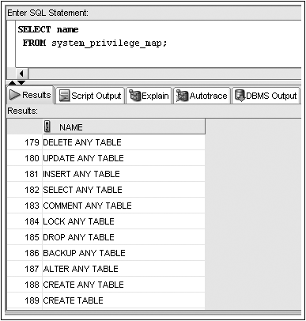
SYSTEM_PRIVILEGE_MAP
Oracle 11g: SQL

Slide 11
Granting System Privileges
System privileges are given through the GRANT command
Oracle 11g: SQL

Slide 12
Granting System Privileges (continued)
GRANT clause – identifies system privileges being granted
TO clause – identifies receiving user or role
WITH ADMIN OPTION clause – allows a user to grant privilege to other database users
Oracle 11g: SQL

Slide 13
Object Privileges
SELECT – display data from table, view, or sequence
INSERT – insert data into table or view
UPDATE – change data in a table or view
DELETE – remove data from a table or view
ALTER – change definition of table or view
Oracle 11g: SQL

Slide 14
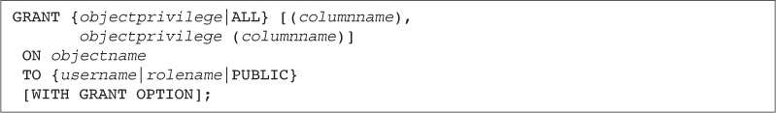
Granting Object Privileges
Grant object privileges through the GRANT command
Oracle 11g: SQL

Slide 15
Granting Object Privileges (continued)
GRANT clause – identifies object privileges
ON clause – identifies object
TO clause – identifies user or role receiving privilege
WITH GRANT OPTION clause – gives a user the ability to assign the same privilege to other users
Oracle 11g: SQL

Slide 16
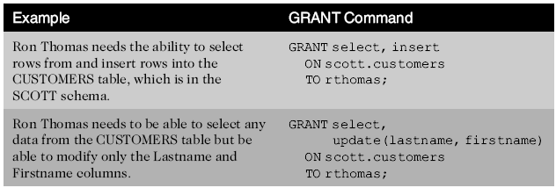
GRANT Command Examples
Oracle 11g: SQL

Slide 17
Password Management
To change a user password, use the PASSWORD command or the ALTER USER command
Oracle 11g: SQL

Slide 18
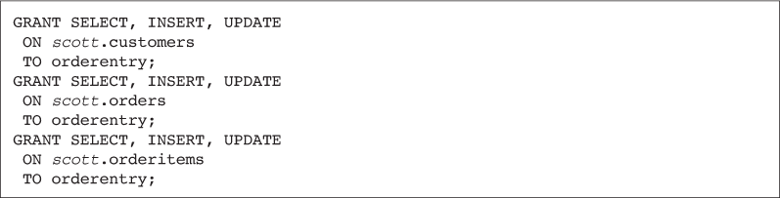
Utilizing Roles
A role is a group, or collection, of privileges
Oracle 11g: SQL

Slide 19
Utilizing Roles (continued)
Roles can be assigned to users or other roles
Oracle 11g: SQL

Slide 20
Utilizing Roles (continued)
A user can be assigned several roles
All roles can be enabled at one time
Only one role can be designated as the default role for each user
Default role can be assigned through the ALTER USER command
Oracle 11g: SQL

Slide 21
Utilizing Roles (continued)
Roles can be modified with the ALTER ROLE command
Roles can be assigned passwords
Oracle 11g: SQL

Slide 22
Viewing Privilege Information
ROLE_SYS_PRIVS lists all system privileges assigned to a role
SESSION_PRIVS lists a user’s currently enabled roles
Oracle 11g: SQL

Slide 23
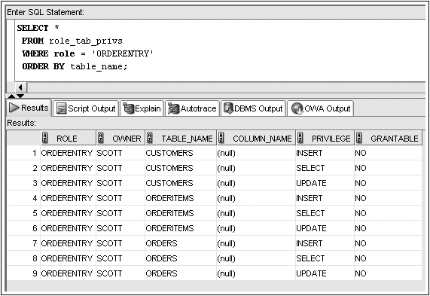
ROLE_TAB_PRIVS Example
Oracle 11g: SQL

Slide 24
Removing Privileges and Roles
Revoke system privileges with the REVOKE command
Oracle 11g: SQL

Slide 25
Removing Privileges and Roles (continued)
Revoking an object privilege – if the privilege was originally granted using WITH GRANT OPTION, the effect cascades and is revoked from subsequent recipients
Oracle 11g: SQL

Slide 26
Removing Privileges and Roles (continued)
Oracle 11g: SQL

Slide 27
Dropping a Role
Users receiving privileges via a role that is dropped will no longer have those privileges available
Oracle 11g: SQL

Slide 28
Dropping a User
The DROP USER command is used to remove a user account
Oracle 11g: SQL

Slide 29
Summary
Database account management is only one facet of data security
A new user account is created with the CREATE USER command
  The IDENTIFIED BY clause contains the password for the account
System privileges are used to grant access to the database and to create, alter, and drop database objects
The CREATE SESSION system privilege is required before a user can access his account on the Oracle server
The system privileges available in Oracle 11g can be viewed through the SYSTEM_PRIVILEGE_MAP
Oracle 11g: SQL

Slide 30
Summary (continued)
Object privileges allow users to manipulate data in database objects
Privileges are given through the GRANT command
The ALTER USER command, combined with the PASSWORD EXPIRE clause, can be used to force a user to change her password upon the next attempted login to the database
The ALTER USER command, combined with the IDENTIFIED BY clause, can be used to change a user’s password
  Privileges can be assigned to roles to make the administration of privileges easier
Oracle 11g: SQL

Slide 31
Summary (continued)
Roles are collections of privileges
The ALTER USER command, combined with the DEFAULT ROLE keywords, can be used to assign a default role(s) to a user
Privileges can be revoked from users and roles using the REVOKE command
Roles can be revoked from users using the REVOKE command
A role can be deleted using the DROP ROLE command
A user account can be deleted using the DROP USER command
Oracle 11g: SQL

